Slide 1


Sales Conversations and Techniques
Movement for Change Workshop

Slide 2
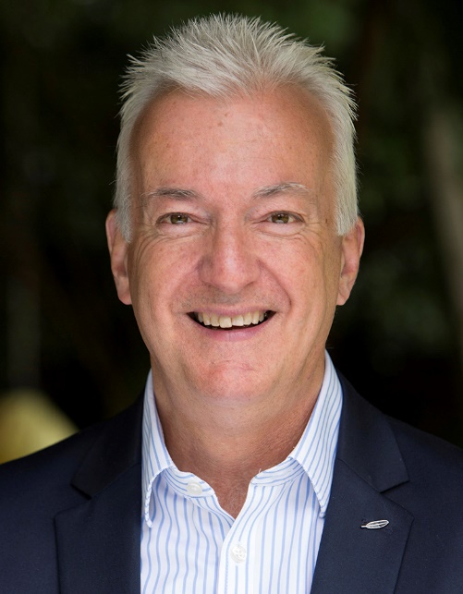

Slide 3
Agenda:
1 Prospecting – how to get F2F
2. F2F Conversations – asking great questions
3. Closing the Opportunity

Slide 4
Principles for New Business Success
Some great axioms and statements to consider:
Start with the end in mind
Be intentional vs accidental
Slow down to speed up
Is the main thing still the main thing?
WTF ?

Slide 5

Session 1: Building a robust sales pipeline

Slide 6

Notes:
LIST THE TOP 10 BEST PROSPECTING METHODS – AND THEN RANK THEM
6

Slide 7

The power of your network
Notes:
Creating your own network
7

Slide 8
Creating a network from scratch:
Social networking may be all the rage, but online acquaintances are probably not going to put their reputations on the line to help you build your business.
That takes a more personal touch.
A business "network" isn't about how many people know your name; it's about how many will send you customers or help you advance your career.
Typically there are four types of people who will trust you enough to give you a referral. Here they are, listed in descending order of their "networking" value:

Slide 9
Creating a network from scratch:
1. Your satisfied clients (present and past).
These are customers who have done enough business with you so that they know, beyond a doubt, that you're a valuable and trusted resource.
2. Your close friends and family.
Your intimates (it's hoped) know that you're trustworthy and are therefore willing to use their connections to help you out. These people are less valuable because they're probably a bit biased.
3. Individuals whom your clients, friends, and family have contacted on your behalf.
In this case, you have a "residue of trust," because the original referrer has endorsed you. Because this is "one step removed," it's a weaker link.
4. Individuals whom you've met through talking with the individuals in Category Three.

Slide 10

Notes:
ICE BREAKER -

Slide 11
Activity:
Write down 5 contacts for each of the following 4 categories:
1. Your satisfied clients (present and past).
These are customers who have done enough business with you so that they know, beyond a doubt, that you're a valuable and trusted resource.
2. Your close friends and family.
Your intimates (it's hoped) know that you're trustworthy and are therefore willing to use their connections to help you out. These people are less valuable because they're probably a bit biased.
3. Individuals whom your clients, friends, and family have contacted on your behalf.
In this case, you have a "residue of trust," because the original referrer has endorsed you. Because this is "one step removed," it's a weaker link.
4. Individuals whom you've met through talking with the individuals in Category Three.
Notes:
OK – so you know have 20 contacts to start working with…..
When you make contact – what are you going to say?
What are your intentions/aspirations
F/C feedback
11

Slide 12
Notes:
ICE BREAKER -

Slide 13
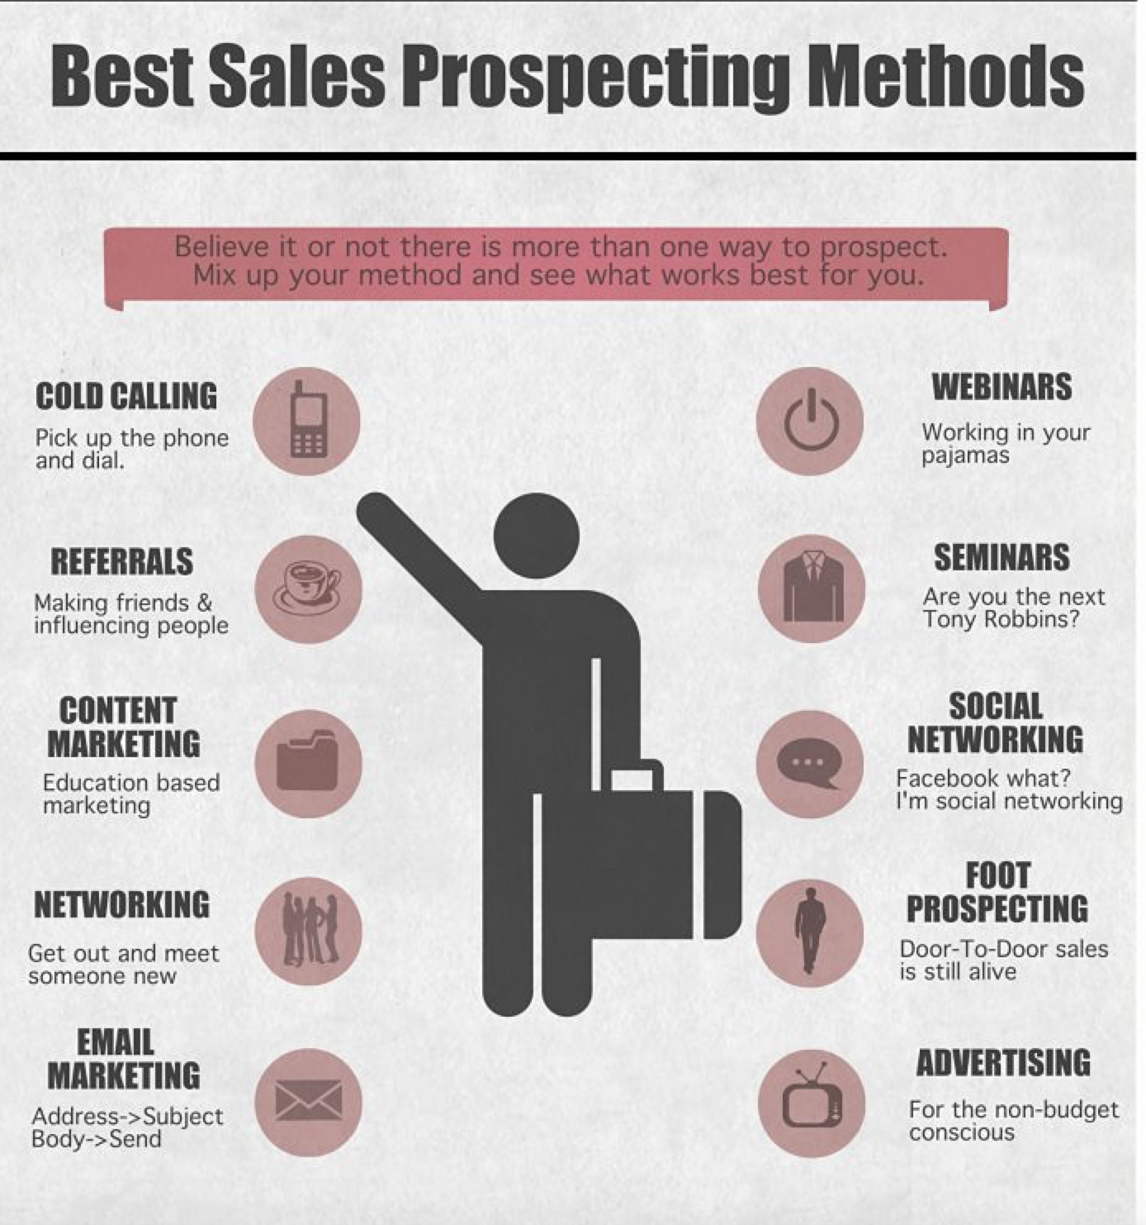

Slide 14
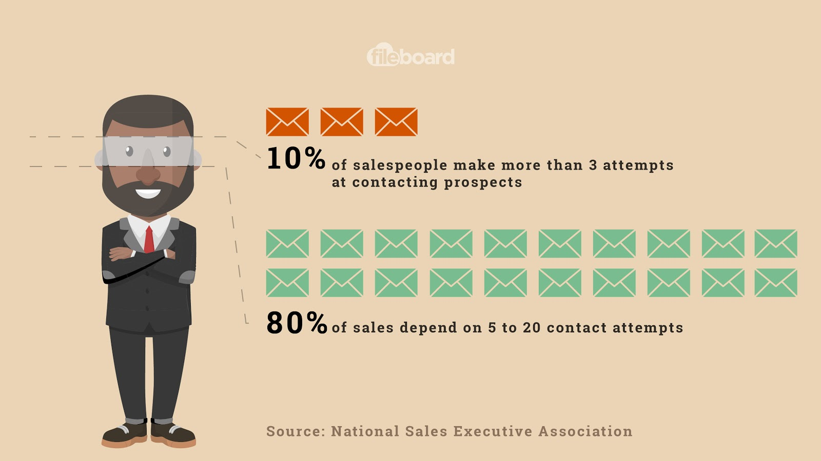
Lead generation
Face to Face we WIN !!

Slide 15




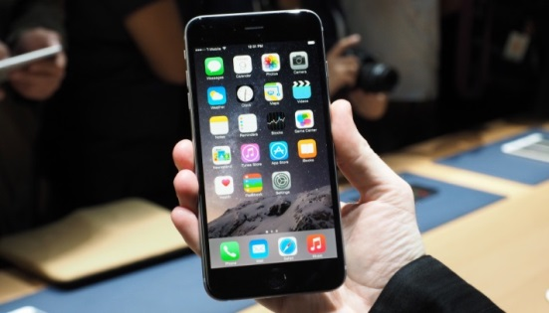
Follow Up:
Frequency:
Notes:
Use a system to log and prompt your follow calls/actions – your memory is not up to the task !!
15

Slide 16
Session 2 – What happens when get F2F?

Slide 18


Slide 19

PRIMED Questioning Model
1. Present Reality (Situation)
5. Decision
2. Issues
4. Evaluation
3. Map of future
Notes:
Relate back to ICEBERG again. Need to ask questions covering several topics
Discussion/model for ‘what are the essential topics to discuss?’
Delegate inputs here What would be the questions to ask on each topic area? Flip responses.
Present Reality (Situation) questions – e.g Current contract/who with/terms/pricing/known desire & needs etc
Issues – Concerns/worries/fears. What do they want to solve? What’s their worst nightmare? How would they feel if it happened?
Map – future changes & requirements.
Evaluation – criteria for evaluation/decision/choice of vendor. Who else have they looked at?
Decision – who, how , when, how much
19

Slide 20
What You Know about Each Account
PR
Present Reality
What’s currently happening?
What’s important to them?
Department\Org Structure
I
Issues
Key Issues and their impact on individuals, organisation, department, their “customers”
M
Map of future
Vision of the future of individuals, organisation, department, “their customers”
Future goals, targets & KPI’s
E
Evaluation
To achieve their vision and solve their issues.
What alternatives have they\are they exploring? What will decisions be based on?
D
Decision
How are decisions made?
Who is involved?
Notes:
ADD MORE QUESTIONS
20

Slide 21
What You Know (And Don’t) about each Account
 | What you know | What you don’t (and need to) | Actions
PR
I
M
E
D
Notes:
FILL OUT THIS FORM - WHERE ARE YOU AT WITH YOUR CLIENTS?
21

Slide 22
Handling Objections:
What are your most common objections ?
Which ones scare you?
Which ones do you want to discuss?
What do you say/do to overcome them ?

Slide 23

ACE those Objections!
Acknowledge
Clarify
Explain
Check that you have resolved the concern
Move forward to the next stage
Notes:
23
Objection Handling model
Importance of Acknowledge to keep Customer on side
Clarification about what the objection is and why it has come up
Only then, overcome
EXERCISE
Agree some common objections with group and flip chart them
Put A/C/E labels on the floor a few feet apart and in one line
Get the group to stand at the side. One volunteer to stand at the ‘A’ end of the line but away from it. Tutor to stand at the ‘E’ end, but away from it. Tutor poses objection, volunteer steps forward to ‘A’ label and acknowledges. Once successfully done, steps forward to ‘C’ label and asks as many clarification questions as necessary. When totally clear about objection and reasons behind it steps forward to ‘E’ label (but doesn’t need to answer that bit (not practicing the answer just the process). Discuss with group.
Rotate with different volunteers and objections

Slide 24
ACE those Objections!
Acknowledge
Clarify
ISOLATE
TRIAL CLOSE
Explain
Check that you have resolved the concern
Move forward to the next stage
Notes:
24
Additional skills
Isolate – apart from that are there any other concerns?
Trial close – If we were able to do anything about that, would you be happy to go ahead etc
Can do similar exercise as last slide but keep brief.

Slide 25
Closing the Sale
How do you currently close the sale?
Do you have a plan?
What’s your preferred method ?

Slide 26
direct approach
Commit
“..are you happy to proceed with this?”
Notes:
26

Slide 27
alternative approach
Commit
“..would you prefer to go ahead with Option 1 or Option 2?”
Notes:
27

Slide 28
assumptive approach
Commit
“So if all that’s OK am I right to say we can go ahead?”
Notes:
28

Slide 29
hypothetical approach
Commit
“You are saying that you want ‘x’ If we can provide all that, are you happy to go ahead?”
Notes:
29

Slide 30
Scarcity approach
Commit
“availability is under pressure – to ensure I can secure ‘X’ for you, I need a PO by …..”
Notes:
30

Slide 31
Q&A Thank You!

